Slide 1
OBC
Prepared by:
Moses Mulwa | Alex Gichamba |Eunice Orenge

Slide 2
OBC Functions
•Recording and storage of telemetry and satellite payload data.
•Encoding and decoding of data packets to and from the ground station.
•Processing of commands from the GS.
•Monitoring other subsystems.
•Implementing watchdog functions.
•Controlling the orientation of the satellite within its orbit.

Slide 3
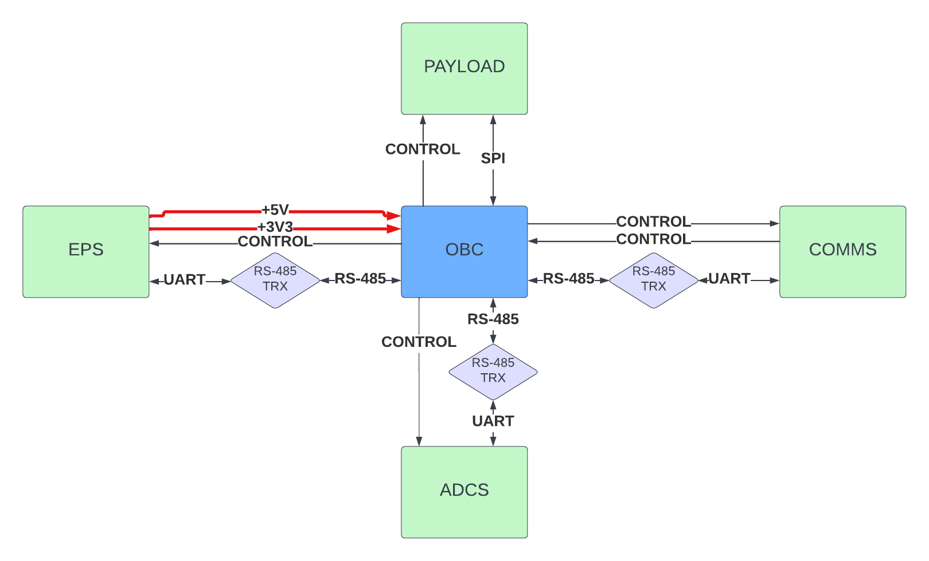
System architecture
Fig 1: System architecture as seen by the OBC

Slide 4
OBC architecture
Processing architecture
Could be centralized to reduce BOM count, complexity and power consumption compared to a distributed architecture.
Software Architecture
A kernel such as FreeRTOS would be suitable as it is thoroughly tested and has been used in space applications.
Software Communication Framework
RS485 to be used for communication between subsystems

Slide 5
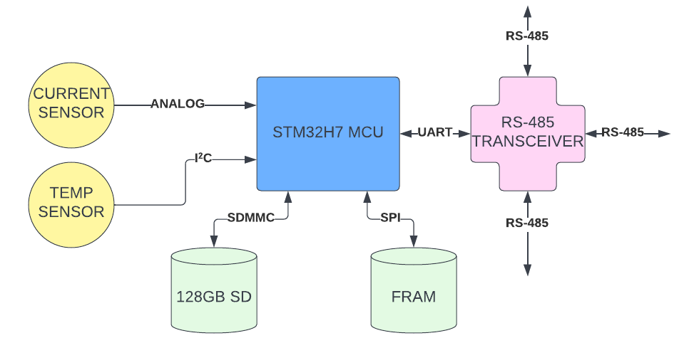
OBC architecture
Fig 2: OBC architecture detailing the components and interfaces used

Slide 6
Some processor requirements
1. High fault-tolerance
This could be achieved by: ECC, CRC modules, Lock-step architecture.
2. Radiation/ionization tolerance
This could be achieved by selecting a radiation hardened chip or having external shielding to minimize SEU, SEL and ionization effects.
3. Floating point precision
Is necessary since some satellite processes require a lot of floating-point calculations. This requires an FPU(single/double precision) and/or DSP slices.
4. Low current consumption
This makes MCUs with low power modes a good option.

Slide 7
I/O
Protocol | Data link | Signalling rate | Possible application
SpaceWire | LVDS | Up to 400Mbps | Payload
CAN | CAN | Up to 1Mbps | Inter-subsystem bus
USB | USB | Up to 480Mbps | External storage/ debugging
RS-232 | UART/USART | Up to 1Mbps | Inter-subsystem bus
RS-485 | UART/USART | Up to 35Mbps | Inter-subsystem bus
I2C | 12C | Up to 3.4Mbps | Sensors
SPI | SPI | Up to 60Mbps | Payload
Table 1: Comparison of possible I/O and their applications

Slide 8
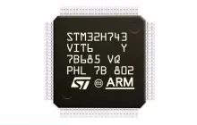
MCU – STM32H743 microcontroller
Features:
ARM Cortex-M7
2MB flash, 1MB SRAM, 32-bit EMIF
Max. clock frequency of 480MHz
CRC calculation unit
4X UART, 6X SPI, 2X CAN, 4X I2C, 2X USB, HDMI
DP-FPU, and DSP
Memory Protection Unit
168 GPIO
Max current consumption 840mA
Unit cost: $44.89
Flight heritage on 6U M6P CubeSat launched in 2019
In stock at LCSC
Fig 3: STM32H743 from STMicroelectronics

Slide 9
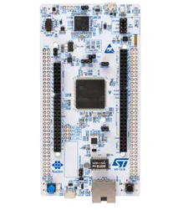
STM32H743 Specifications
Weight
3g
Size
14 x 14 mm
Package
LQFP-100
Fig 4: STM32H755 development kit

Slide 10
STM32H743 Development
Hardware Development
Development kits for prototyping are available starting from $28.42
Reference designs are provided by ST
Software Development
STM32 CubeIDE by ST supports the STM32H743. It allows for code editing, debugging, code generation and run-time resource estimation.
HAL libraries are available.
FreeRTOS is supported.
Programmer’s manuals, application notes are in plenty.
An existing developer community has been identified with a discussion forum at Community.St and Electronics Stack Exchange.
Fig 4: STM32H755 development kit

Slide 11
OBC
Communication Protocol
RS485 was chosen as the communication protocol to be used between subsystems. Other sensors and devices will use their default protocols.
Transceivers for the RS485 have been chosen.
Storage
A 128 GB SD card was chosen. An SD Card Mount will also be included to facilitate this.
Memory
A 2 Mb FRAM will be added to supplement the existing RAM capabilities.

Slide 12
OBC
Extra devices needed for MCU support
VDDA Filters, HSE and LSE Oscillators, Capacitors e.t.c have been added.
Sensors
Current, Temperature sensors have been chosen to aid in system status monitoring.
Redundancy
A VBAT has been added to power the real time clock and SRAM if VDD goes low.

Slide 13
OBC
Redundancy
All OBC components will have spares for testing and also to aid in situations of failure.

Slide 14
OBC
Weight
The OBC system has a maximum of about 100g. All components have about 50g. Even after adding connectors, PCB etc. The weight will not surpass 150g.
Size
PC104 (90 × 96 mm) with a height of about 15 mm
Price
$100 per system. For redundancy, three systems will be made. Even after adding development requirements, the price maxes out at $1000.
Manufacturer
JLCPCB has been chosen as the PCB Manufacturer and LCSC as the part supplier.

Slide 15
OBC Challenges
Complexity
Due to its central nature to the entire satellite, it tends to be a complex system to design and monitor.
Component supply uncertainty
Although all the selected components for the OBC are currently in stock, a few parts are not heavily stocked and large entities could buy up all the remaining supply. It is for this reason that we request that the procurement process begins as soon as the designs are approved.

Slide 16
OBC operating conditions
Part | Description | Min ambient temp (ºC) | Max ambient temp (ºC)
STM32H743VIT6 | Microcontroller | -40 | +85
TMP102AIDRLR | Temperature sensor | -40 | +125
SN65HVD75DR | RS-485 transceiver | -40 | +125
ACS712ELCTR-05B-T | Current sensor | -40 | +85
TF101 | SD card | -25 | +85
SMD caps and resistors | Capacitors and Resistors | -40 | +85/+125
HSE and LSE | Crystal oscillators | -40 | +85
CR2032 | 3V coin battery | -30 | +60
MB85RS2MTAPNF | FRAM | -40 | +85
Table 2: Operating conditions for OBC parts

Slide 17
OBC power supply requirements
Part | Description | Input voltage(V) | Input Current (mA)
STM32H743VIT6 | Microcontroller | 3.3V | 840
TMP102AIDRLR | Temperature sensor | 3.3V | 0.01
SN65HVD75DR | RS-485 transceiver | 3.3V | 1
ACS712ELCTR-05B-T | Current sensor | 5V | 10
TF101 | SD card | 3.3V | 150
MB85RS2MTAPNF | FRAM | 3.3V | 2.3
Table 3: Power requirements of OBC parts

Slide 18
OBC power dissipation
Part | Description | Thermal resistance, θja (ºC/W) | Maximum power dissipation (W)
STM32H743VIT6 | Microcontroller | 45 | 0.889
TMP102AIDRLR | Temperature sensor | 210.3 | negligible
SN65HVD75DR | RS-485 transceiver | 110.7 | 0.23
ACS712ELCTR-05B-T | Current sensor | 23 | <0.2
MB85RS2MTAPNF | FRAM | Not provided | 0.0079
TF101 | SD card | Not provided | 0.495
Table 4: Maximum power dissipation for OBC parts.

Slide 19
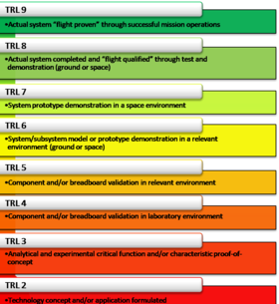
OBC - Technology Readiness
Part | TRL level
Microcontroller | 9 – Proven heritage: M6P
Temperature sensor | 9 – Proven heritage: ArduSat
RS-485 transceiver | 9 - Proven heritage: MiRaTA
Current sensor | 5 - Component validation
FRAM | 5 - Component validation
SD card | 5 - Component validation
Table 5: Technology readiness of OBC parts.
Fig 5: NASA TRL levels

Slide 20
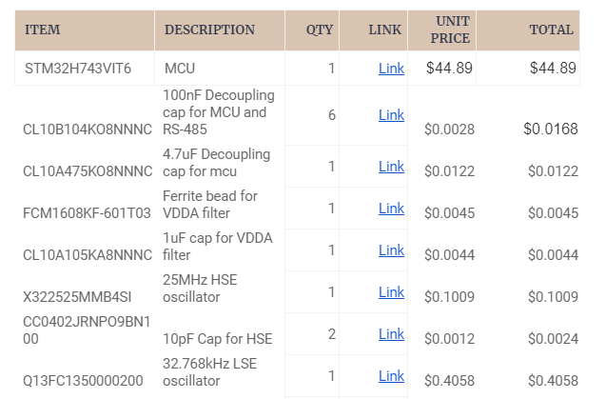
OBC BOM

Slide 21
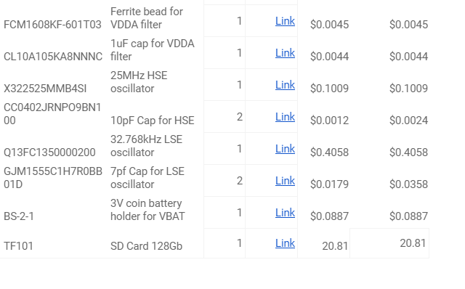
OBC BOM

Slide 22
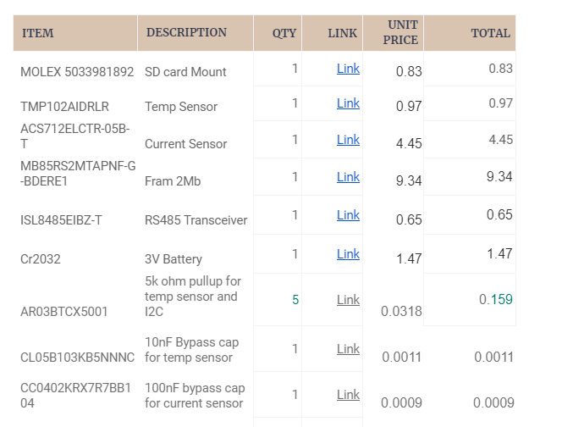
OBC BOM

Slide 23
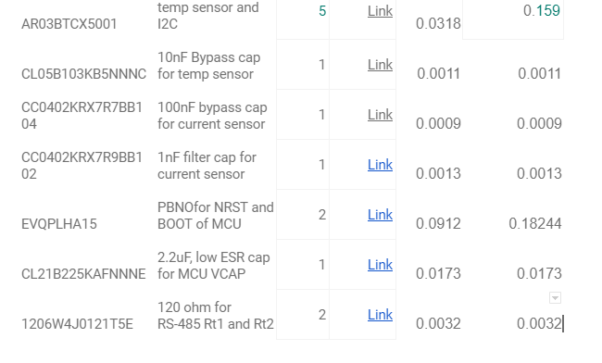
OBC BOM

Slide 24
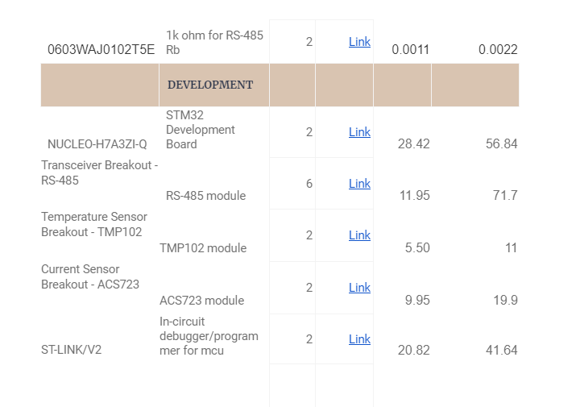
OBC BOM

Slide 25
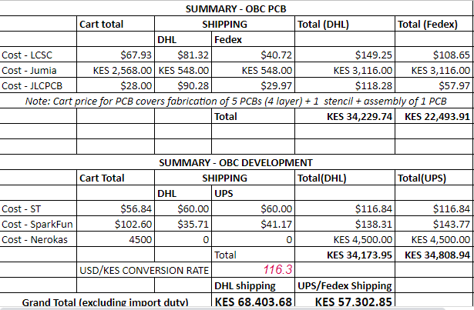
OBC BOM summary

Slide 26
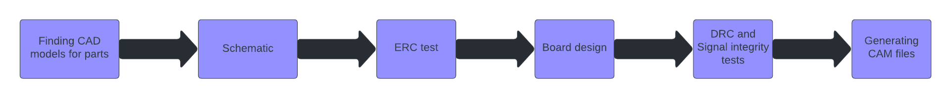
OBC Hardware Design – The Process
After defining the OBC’s architecture, design began shortly after.
The design is being guided by the relevant hardware development application guides from the part manufacturers.
To ensure the design is manufacturable by the fabricator, JLCPCB, all our design constraints such as spacings and via sizes are safely within their manufacturing capabilities.
Fig 1: OBC hardware design process

Slide 27
OBC Hardware Design – Initial Design
The OBC team intends to develop two designs, where the second will be an improvement of the first.
This first design will incorporate some added features for testing and fault-finding. This will help to gather necessary data that can be used to improve the next design, and ‘debug’. These features include:
extra test points along communication buses – Signal properties will be investigated with an oscilloscope.
Extra LEDs
Using the knowledge gained from the first design, the second one will be optimized for performance.

Slide 28
OBC Hardware Design – Software and the Schematic
Altium Designer has been preferred for these designs because:
It has advanced part-searching tools which save time that would be spent on individually searching for CAD models.
Superior UI to other ECAD software makes the design process faster.
It is used by Sayari Labs. In case we would require them to review our designs, it helps to have both teams using the same design software.
The software is free for students, and so this comes at no extra cost.
The schematic has three sheets:
The MCU and it’s system components
Sensors, External memories, and the RS-485 transceiver
Connectors to other boards

Slide 29
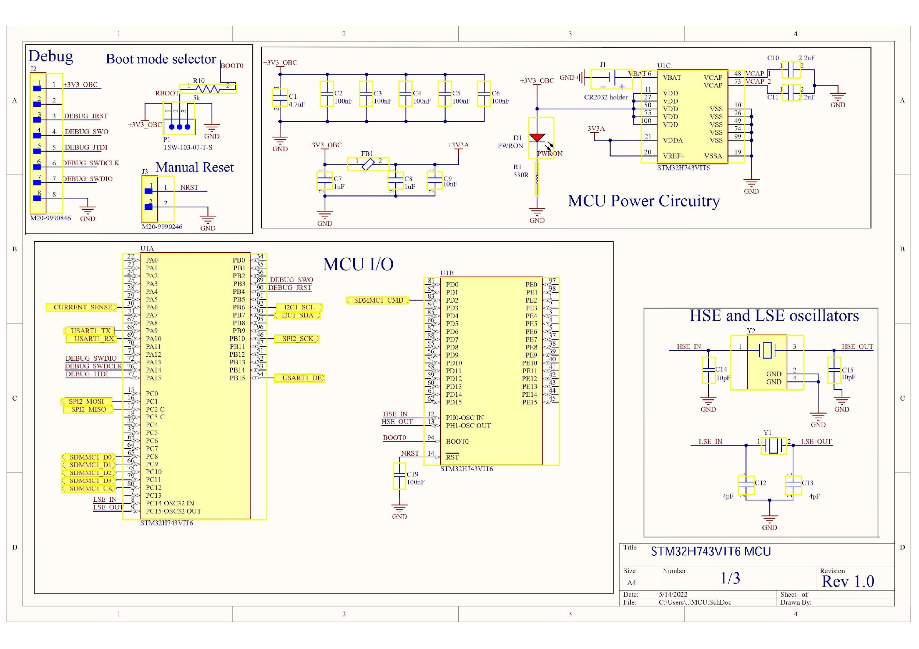
Fig 2: Schematic Sheet with the STM32 MCU’s system

Slide 30
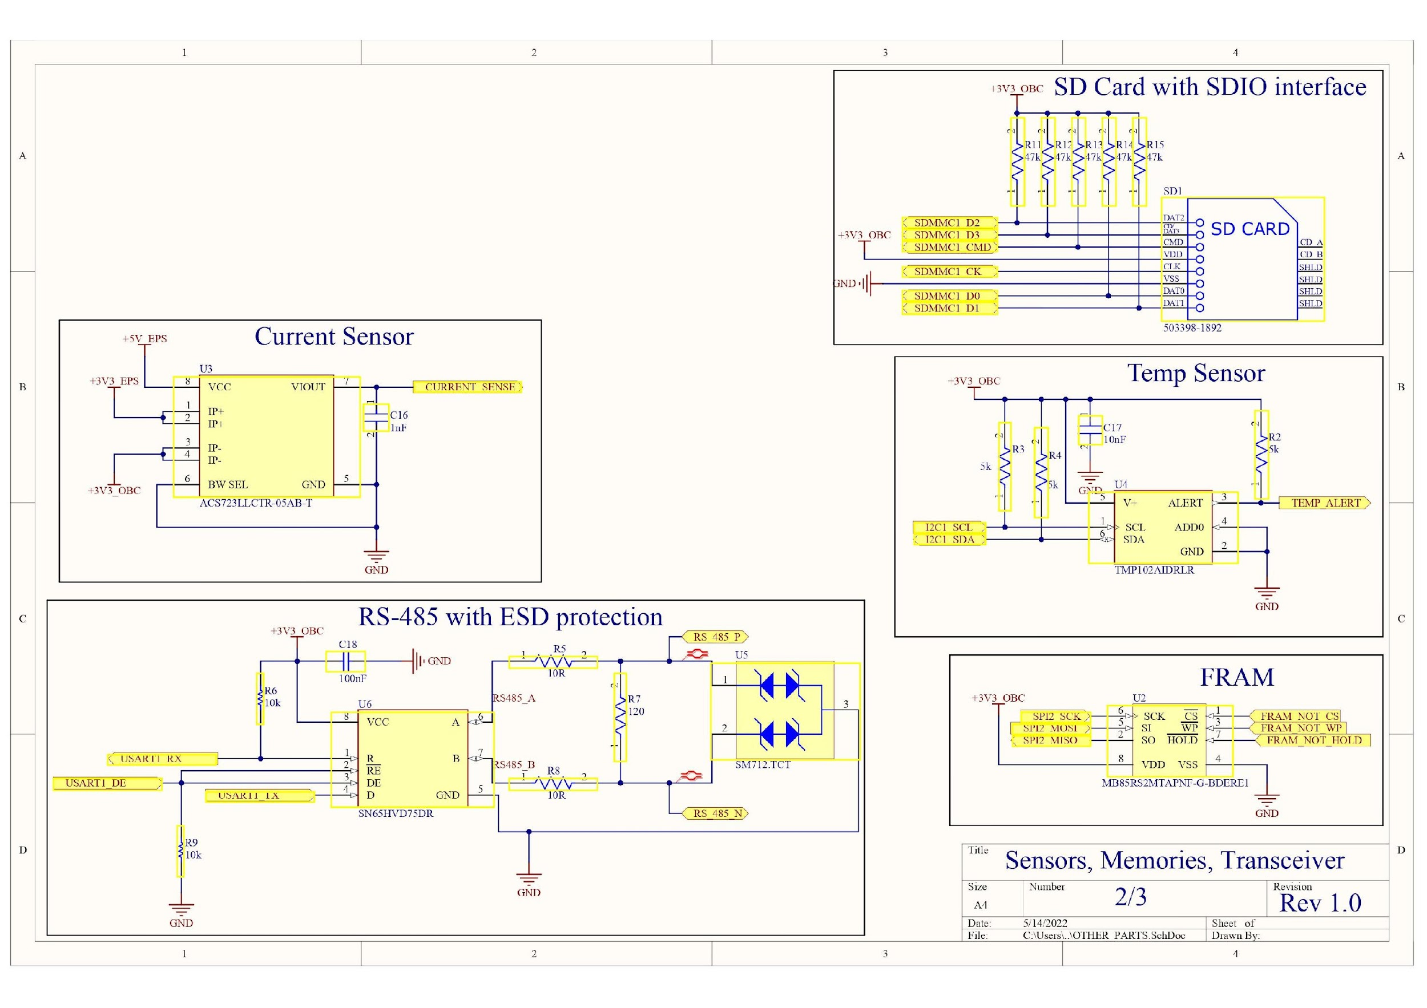
Fig 3: Schematic Sheet with sensors, memories and the RS-485 transceiver

Slide 31
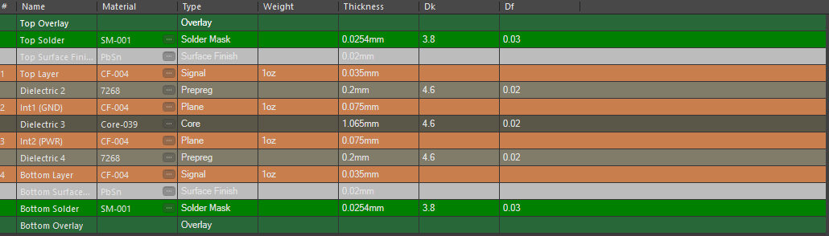
OBC Hardware Design – The Board
The design guides for the microcontroller and the RS-485 transceiver recommend a four-layer (or more) stack-up given that some buses have high signalling rates. This would help to improve the integrity of the signals.
We are working with a four-layer stack-up but this, and a few other design choices, may be subject to change after the signal integrity tests.
Fig 5: The four-layer board’s stack up

Slide 32
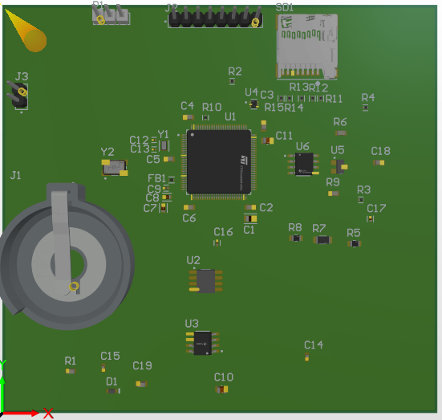
SD Card mount
Port for debugging with STLink or JTAG
RS-485 Transceiver
Temp Sensor
STM32H7 MCU
FRAM
Holder for the 3V Coin battery
Current Sensor
Fig 5: Layout of components on a 90 by 96 mm board

Slide 33
OBC Hardware Design – Moving forward
The design files can be viewed in the Tafiti GitHub.
As may be seen from the schematics, only the nets within the OBC have been defined.
To continue with the design, we would need to have the PCB stacking connector and its pin assignment defined.
This will allow the OBC team to determine the connections it shares with other subsystems.
Once this is done, the schematics will be finished, and signal routing may begin.

Slide 34
Thank You

Slide 35
Payload
Prepared by:
Alex Gichamba | Moses Mulwa

Slide 36
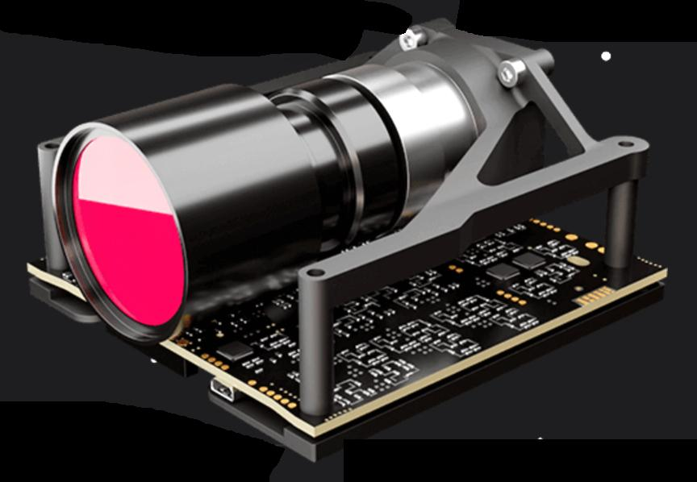
The Imager - Gecko
The imager chosen for the OBC is the Gecko imager from Dragonfly Aerospace. It offers:
RGB (Bayer) matrix imaging
39m spatial resolution
80km swath at 500km
128GB integrated mass storage
RAW or J2K lossless/lossy compression
Fig 1: The Gecko imager from Dragonfly

Slide 37
Imager – Size, Mass, Temperature, and Rad. Tolerance
The imager is in a 1U form factor with the dimensions:
10cm by 10cm by 6.5cm
Its total mass is 0.4kg.
Its operating temperature range is:
0ºC to 30ºC
Its survival temperature range is: -20ºC to 70ºC
It has passed a Total Ionizing Dose (TID) at:
30krad

Slide 38
Imager – Power Budget
Parameter | Rating
Voltage | +5V
Power consumption during readout mode | 4.5W
Power consumption during imaging mode | 2.6W
Table 1: Gecko imager power budget
The +5V rail supplying the payload should be able to source at least 1A

Slide 39
Imager – Interface options
Data link | Data rate | Interface available for STM32H7 OBC
LVDS | >155 Mbps | No
CAN | Up to 1 Mbps | Yes
I²C | Up to 3.4 Mbps | Yes
SPI | Up to 60Mbps | Yes
Table 2: Comparison of the payload’s possible interfaces
LVDS would have been optimal, but the OBC’s microcontroller does not support LVDS natively. This would need a MIPI DSI/LVDS converter such as the SN65DSI from Texas Instruments.
SPI is the next best option.

Slide 40
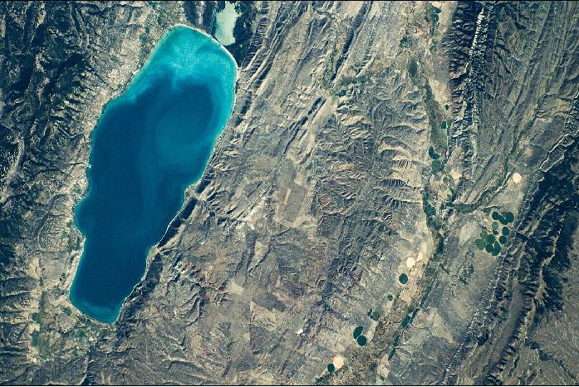
Imager – Technology Readiness
The Gecko has proven flight heritage on successful missions including:
nSight-1
Gaia 3U
This gives it the maximum score of 9 on NASA’s technology readiness level (TRL) test.
Fig 2: An image of Lake Utah taken by the Gecko imager on board nSight-1

Slide 41
Thank You

Slide 42
Communication Subsystem
Presented by:
Anna Kamene| Gerald Mbuthia|Timothy Ndichu |Peres Daphny

Slide 43
Communication Subsytem Functions
The main functions of the Communication subsystem are:
• To send data from the satellite to the ground station and,
• To distribute commands from the ground station to the satellite

Slide 44
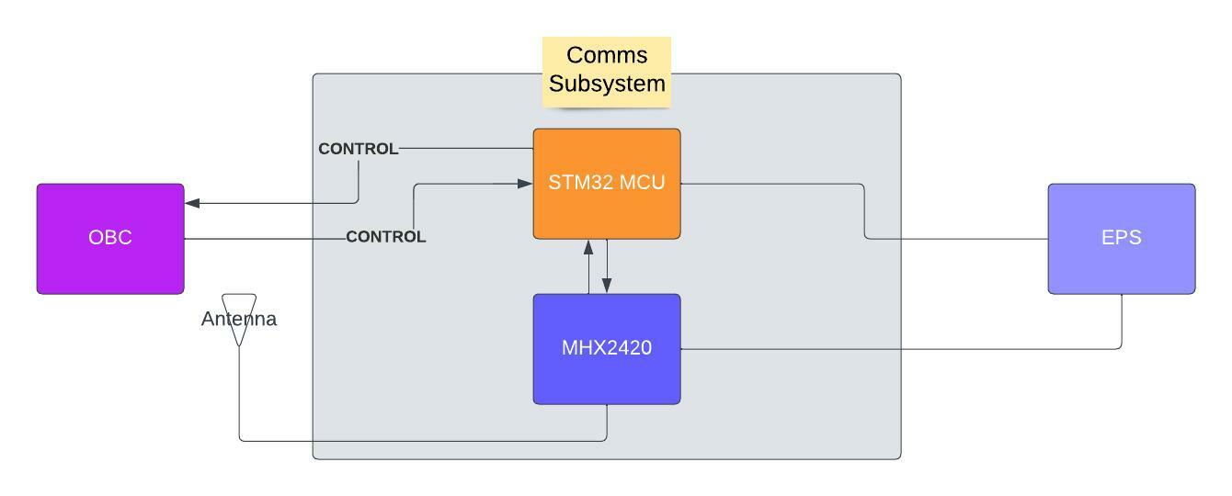
General Subsystem Architecture

Slide 45
Communication System Architecture and Hardware
The nanosatellite communication system architecture required critical consideration of data being forwarded, size of the data, common architectures in use for satellite development as well as power consumption. Data transferred to and from the nano-satellite include:
Payload data
Housekeeping data such as telemetry, system health and telecommand.
Beaconing
The data sets listed above all require varying communication channels with specific requirements. This requirement includes but are not limited to:
Transmission band
Data rates
Transmission power
Noise immunity
Modulation Techniques

Slide 46
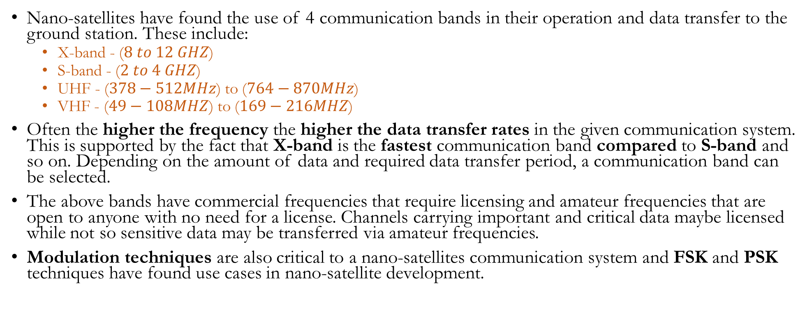
Bands for Communication in Cubesats

Slide 47
Tafiti On-board Communication System Architecture and Hardware.
The Tafiti Cubesat communication system will have to be able to transfer a huge payload data, housekeeping data and allow for telemetry, tracking and telecommand. To achieve this, atleast 2 independent channels will be used to achieve this.
One channel will be a high data rate channel to transfer the payload data while the second channel will be one to carry out housekeeping data transfer along with telemetry, tracking and telecommand.
The roles of the second channel maybe shared out to another channel in the case where the ground station requires uninterrupted transfer of the telemetry and tracking data. Telemetry and tracking data may be useful at the ground station to design a tracking system to point the antennas towards the orbiting CubeSat.
In-house design and fabrication of communication systems for a CubeSat was found to be a very common practice by numerous organizations as this made it easier to have complete control of the specifications being exactly what is required. This however needs high level expertise as well as capital investment. These initial expenses would be offset by the cost savings and revenue generated from subsequent launches and sales.

Slide 48
Tafiti On-board Communication System Architecture and Hardware.
The following describes the approach in which the full communication system will be realized:
Payload data transfer
Telemetry, Tracking and Tele-command data transfer
Antennas
Ground Station

Slide 49
Payload data transfer
High amounts of data from the camera payload will need to be transmitted through this channel.
The requirements of this channel should include the following:
High data rates
Low power consumption
Minimal weight
A suitable supply voltage range
Good flight heritage
Suitable dimensions for 3U sized CubeSats
A wide range of operating temperature
Transmission mode can also be a factor to be considered especially if transmission is intended to occur bi-directionally.

Slide 50
Payload data transfer
COTS have proved to be the best way to carry out our communication development and numerous companies are present in this space providing products for particular needs. Pricing has been an issue however but we managed to get feedback on the same from two manufactures. Endurosat and Nanoavionics with the latter showing a keen interest in partnering with Kenya Space Agency.
The hardware from the above companies that can be used in our system include S-band and X-band transceivers.

Slide 51
X-band Transceivers
Endurosat X-band transceiver features
Information Data rate | Upto 124Mbps with a gross of 150Mbps
Frequency range | 7.9 – 8.4 GHz
Frequency Tuning Step | 1kHz
Symbol rate | 1-30Msym/s
RF Output Power | 27-33dBm, 1dB step
Signal to noise ratio | 21-30 dB
Spurious Emissions | < -60dBc
Modulation | QPSK, 8-PSK, 16-APSK, 32-APSK
Protocols | DVB-S@ -ETSI EN 302 307-1 v1.4.1(standard), CCSDS 131.0-B-3(option upon request)

Slide 52
X-band Transceivers
Endurosat X-band transceiver features
Supply Voltage | 12 - 24V
Low Power Consumption: Load Mode | 0.42W
Low Power Consumption: Transmit Mode | 18W at 33dBm RF output Power
SD Card | Up to 32GB
Module management Interfaces | RS-485 or UART via ESUP
Data Transmission Interfaces | RS-485 or UART via ESUP for SD card access (store and forward data). LVDS for real time data transmission, available on PC-104 or dedicated connector.
Control and monitoring | GUI available

Slide 53
X-band Transceivers
Endurosat X-band transceiver features
Connectors | PC-104, LVDS connector
RF Connector | 50 ohms female SMA, straight or R/A
Mass | 275g
Operating temperature | - 30 to 70 °C
Dimensions | 90.2 x 96 x 22.5 mm full dimensions (Some dimension variations are present)
Tests | Fully tested for 6 qualification tests
Cost | $ 29900 (Ksh. 3,468,998)

Slide 54
S-band Transceivers
Features | Endurosat S-band Transmitter | SAtlab SRS-3
Transmission mode | Simplex mode | Full duplex
Information Data rate | Upto 17 Mbps gross 20MBps | TX: 128 to 512kbps RX: 128kbps
Frequency range | Commercial: 2200 – 2290 MHz Amateur: 2400 – 2450MHZ | TX:2200 – 2290MHz RX:2025 to 2110MHz
Frequency Tuning Step | 1kHz | N/A
Symbol rate | 1-5 Msym/s | N/A
RF Output Power | 27-33dBm, 1dB step | Adjustable 20-30Dbm with ALC

Slide 55
S-band Transceivers
Features | Endurosat S-band Transmitter | SAtlab SRS-3
Signal to noise ratio | 28-35 dB | N/A
Receiver sensitivity | none | -104dBm
Spurious Emissions | < -60dBc | N/A
Supply Voltage | 9 - 15V or 5v | 5 - 40V
Low Power Consumption: Load Mode | 0.42W | 550mW
Low Power Consumption: Transmit Mode | 7.2 W at 32dBm RF output Power | 5.0W at full duplex
Modulation | QPSK, 8-PSK, 16-APSK | GMSK
Protocols | DVB-S@ -ETSI EN 302 307-1 v1.4.1, CCSDS 131.0-B-3(option upon request) | N/A

Slide 56
S-band Transceivers
Features | Endurosat S-band Transmitter | SAtlab SRS-3
SD Card | Up to 32GB | TBC
Module management Interfaces | RS-485 or UART via ESUP | CAN, RS-422, Ethernet
Data Transmission Interfaces | RS-485 or UART via ESUP for SD card access (store and forward data) LVDS for real time data transmission, available on PC-104 or dedicated connector | N/A
Connectors | PC-104, LVDS connector | Amphenol Coaxial SMP connectors
RF Connector | 50 ohms female SMA, straight or R/A | N/A

Slide 57
S-band Transceivers
Features | Endurosat S-band Transmitter | SAtlab SRS-3
Control and monitoring | GUI available and Telemetry downlink | Debugger – On ground Telemetry
Mass | 180g | 190g
Operating Temperature | -30 to 70 ℃ | RX: -30 to 85 ℃ TX: -30 to 70 ℃
Dimensions | 90.2* 96*22.5 mm full dimensions | 87*93*17 mm
RF Connector | 50 ohms female SMA, straight or R/A | N/A
Tests | Fully tested for 6 qualification tests | Fully tested for 4 qualification tests (non-exhaustive list)
Cost | $ 13500 | $ 15330

Slide 58
Payload data transfer in a nut-shell
For the payload communication the higher X-band’s data rate would be ideal to ensure fast data transfer compared to the S-band’s data rate. The S-band transmitter would be a great alternative with a few extra tweaks being performed to reduce data to be sent.
The Endurosat transmitters do not require a microcontroller implemented to carry out their functions as they have inbuilt controllers and can thus fetch data from storage.
It is worth noting that the Endurosat’s communication modules have built-in telemetry transfer capabilities built into them. They also exhibit high data rates as well as well documented specifications for each module. They have a great flight heritage that can be seen from the wide connections and partnership with over 90 leading satellite development organizations.

Slide 59
Telemetry, Tracking and Tele-command data transfer -UHF Transceiver
Features | Endurosat UHF Transciever II | Nanoavionics UHF radio SAT2RF1-1D
Transmission mode | Half duplex | Half duplex
Information Data rate | Upto 19.6 kbps configurable | 2.4/4.8/9.6kbps
Frequency range | Commercial: 400 – 403MHz Amateur: 430 – 440MHz (both TX, RX) | 395 – 440MHz Both commercial and Amateur
Receiver sensitivity | -121dBm | -122dBm
Modulation | 2GFSK(default), OOK, GMSK, 2FSK,4FSK, 4GFSK(upon request) | GFSK2(MSK)
Protocols | ESSTC, transparent, AX.25 | TBC
SD Card | External FRAM | To be custom made

Slide 60
Telemetry, Tracking and Tele-command data transfer -UHF Transceiver
Features | Endurosat UHF Transciever II | Nanoavionics UHF radio SAT2RF1-1D
Supply Voltage | 3.3V or 5V configurable | 3.3V
Power Consumption: Load Mode | 1W and customizable to 2W | 3W
Module management Interfaces | RS-485 or UART via ESUP | CAN and UART
Data Transmission Interfaces | UART, I2C,USB(VCP default), RS-485(upon request) | N/A
Connectors | Main Stack Connectors, MMCX connector, USB-connector, RS-485 connector, Test mode jumper | N/A
RF Connector | 50 ohms female SMA, straight or R/A | MCX 50 Ohm RF Connector
Control and monitoring | AX.25 Telemetry beacon broadcast both audio and Morse code beacon | N/A

Slide 61
Telemetry, Tracking and Tele-command data transfer -UHF Transceiver
Features | Endurosat UHF Transciever II | Nanoavionics UHF radio SAT2RF1-1D
Mass | 90g | 7.5g
Operating Temperature | -30 to 80 ℃ | -40 to 85 ℃
Dimensions | 89* 95*11 mm full dimensions (Some dimension variations are present) | 32.9*56.10*5.38 Will require a PCB designed and fabricated to add in PC-104 connectivity
Tests | Fully tested for 6 qualification tests | Not specified
Cost | $ 5500 | $ 2500

Slide 62
Telemetry, Tracking and Tele-command data transfer -UHF Transceiver
The UHF transceiver is a perfect channel to transfer Telemetry, Tracking and Tele-command data.
The Endurosat transceiver is well built with convectional features that allow it to be the best choice compared to its closest competitor.
Purchase of the X-band or S-band transmitters may relieve bandwidth to perform tracking and tele-command. This is important especially since the UHF transceiver is a half-duplex and thus communication occurs in one direction at a time.
No microcontroller is needed for the Endurosat transmitter.

Slide 63
Antennas
The above transmitters and transceivers require antennas to receive and send out the various frequencies. Special antennas are needed for each band for optimal performance and high efficiency. The various antennas for the given bands include:
X-band /S-band – Patch antennas.
UHF band – Dipole antennas
Acquisition of the dipole antenna is easy and quite cheap. However, Patch array antennas are quite expensive. Endurosat sell antennas at the given rates.

Slide 64
Antennas
Antenna | Cost
X-band 4*4 Patch Array | $8400
X-band 2*2 Patch Array | $5800
X-band Patch Array | $4500
UHF antenna 2U | $9100 (6U)
UHF Antenna III | $4600-$7200
S-Band Antenna Commercial | $3600
S-Band Antenna ISM | $3600
S-Band Antenna Wideband | $5600
*Patch Antennas can be designed on PCB boards making it cost effective for the project.

Slide 65
Ground-Station
This will provide the grounded terminal that will be in direct communication with nano-satellite. The ground station requires:
X-band /S-band receiver
UHF transceiver at half duplex transmission mode
Modulator and demodulator circuitry preferably within the receiver
Ground antennas for the given transmission bands
Computing power to provide data processing and storage. This may also include an internet connection and custom made algorithms to process and extract meaningful data from the payload.

Slide 66
Software Defined Radios (SDRs)
A hardware based ground station maybe possible to acquire at a very high cost which wouldn’t be ideal.
Software Defined Radios become an ideal solution for our use case.
SDRs are reconfigurable and reprogrammable radio that can show different functionality with the same hardware. Modulation and demodulation functions are defined in software rather than hardware.
It can be described as generic hardware with software that meets the given needs. It can thus be considered a multi-modulation scheme system in terms of hardware for little cost.
For the ground station, SDRs capable to tune to the given operating frequencies i.e. transmission, reception or both are obtained equal to the number of individual channels of communication present. The characteristics of the frequency expected to and fro the on-board transmitter or transceiver are matched by software onto the SDR and the data can be successfully extracted.
Below are great picks that fit the communication systems needs.

Slide 67
Software Defined Radios (SDRs)
HackRF One XR-029 – Great Scott Gadgets:
Specifications:
1MHz – 6 GHz
Half-duplex SDR Transceiver
Data bandwidth 20MHz
Transmitting power: 10dBm
64QAM transmitting EVM: 1.5%
20 million samples/second i.e. 20Mbps
8-bit quadrature samples; 8-bit I and 8-bit Q
Compatible with GNU radio, SDR# and more
Software Configurable RX and TX gain and baseband filter
Software controlled antenna port

Slide 68
Software Defined Radios (SDRs)
Includes:
1 HackRf Development board with Acrylic shell
1 USB cable
1 UHF antenna (40MHz – 6GHz)
1 UHF/VHF antenna
1 TCXO clock 0.1ppm
The above SDR can comfortably receive S-band and UHF signals. An antenna designed for the S-band will however be required. The device costs $121.99 on elecbee.com. If we were to go with an S-band and UHF communication duo, two of these devices would be required since only one channel can be operated on by a single SDR.

Slide 69
Concept Studies
The calculations here will make use of a payload that will closely depict how the Nanosatellite will be transmitting and receiving data.
The payload chosen for the mission is the Gecko Imager and will be used in this hypothesis:
Firstly, a data budget will need be determined

Slide 70
Data Budget
Taking the Gecko Imager, we first obtain the resolution:
Resolution = (2048 x 2048) = 4194304 Pixels
Frame Rates : 7fps
From this, we obtain the data per second in pixels:
Data per second = 4194304 x 7 = 29360128 pixels
The data format can range from 8bit – 16bit, with 16bit being a high quality imager.
Next we will determine the no. of bits (with compression applied)

Slide 71
Data Budget
•To calculate the number of bits:
•For 8 bits : 8 x 29360128 = 234,881,024 bps(bits per second)
•For 10 bits : 10 x 29360128 = 293,601,280 bps
•For 16 bits: 16 x 29360128 = 469,762,048 bps
•The compression can either be RAW or J2K or Lossy.
•Compression adds a number of redundant bits that need to accounted for.
•It is also necessary to break down the bits into frames. This is to avoid errors & failures in transmission of data.
•Frames provides a manageable unit for error handling.
•To account for these redundant bits, we add about 50% of bits/sec to the number of bits. E.g: for 8bits, 150/100 x 234 881 024=352, 321,536bps

Slide 72
Data Rate
The air data rate = Throughput + support bits where throughput is the meaningful info from the camera and support bits are for intelligible recovery of data.
Of most importance to the mission is the selection of the appropriate band to be used to communicate with the ground station.
To calculate the air data rate:
For 8 bits : 1.5 x 234,881,024 bps = 352,321,536 bps(bits per second)
For 10 bits : 1.5 x 293,601,280 = 440,401,920 bps
For 16 bits: 16 x 469,762,048 = 704,643,072 bps
To Mbps, this will approximately translate to:
For 8 bits = 336Mbps
For 10 bits = 420Mbps
For 16 bits = 672Mbps
For this, onboard storage is required
Taking pictures and sending frames at the same time

Slide 73
Frequency bands
To compare the time needed to live-stream the data: we will take 8bit (transmitting 336Mbps)
S-band :
Mostly transmits at 5-20Mbps
Taking 5Mbps, it will transmit 336Mbps in 67.2 secs
Taking 20Mbps, it will transmit 336Mbps in 16.8 secs
X-band :
Mostly transmits at 50-100Mbps
Taking 50Mbps, it will transmit 336Mbps in 6.72 secs
Taking 100Mbps, it will transmit 336Mbps in 3.36 secs

Slide 74
Frequency bands
Assuming satellite is in view of Ground Station for 10mins (600secs), to calculate amount of data:
For:
5Mbps: 600 x 5 = 3000Mb = 375MB = 0.366GB
20Mbps: 600 x20 = 12000Mb = 1500MB = 1.465GB
50Mbps: 600 x 50 = 30000Mb = 3750MB = 3.66GB
100Mbps: 600 x 100 = 60000Mb = 7500MB = 7.32GB
For a payload of 336Mbps, In 600s:
Payload = 336 x 600
= 201600 Mb
= 25200 Mb
= 24.61GB
Taking an onboard storage of 128GB, this clearly shows that it can handle payload.

Slide 75
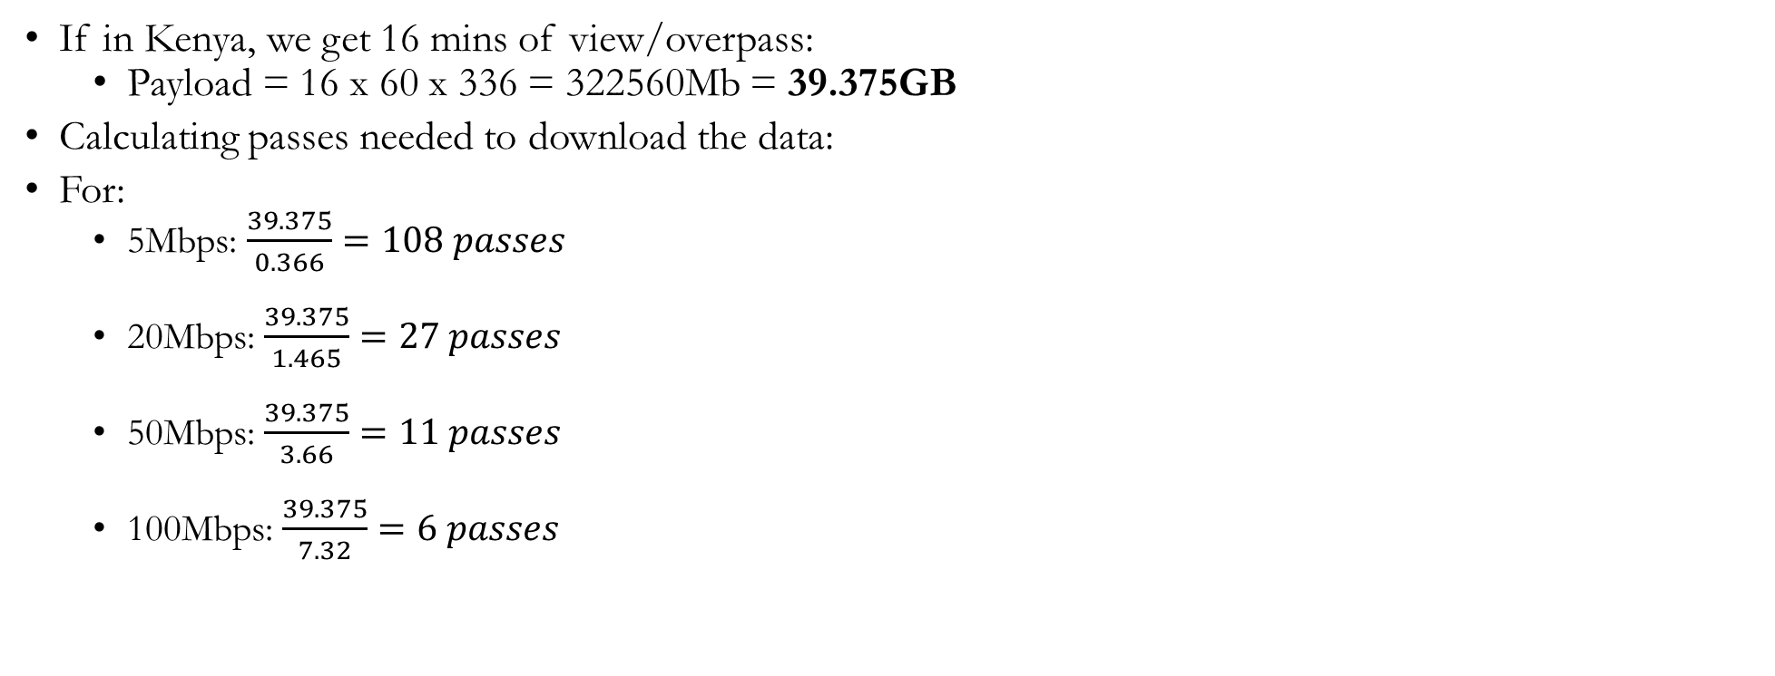
Frequency bands

Slide 76
Frequency bands
Assuming 16 passes per day, 8 passes at night, 8 in the day (However payload only happens during the day):
Payload Data:
Payload = 8 x 39.375 = 315GB (Exceeds 128GB storage)
Comms data (operates in all passes)
Download = 16 x 7.32 = 117.12 GB
The gap between Comms data and Payload data can be bridged by:
More powerful X-band
More ground stations
Designing the band for more efficient air data rate i.e adding less bits to throughput, more bit efficient S or X band
Using most optimal fps e.g 3fps for less data
Pixel binning e.g if 24pixels, 4 pixels merged but bit depth remains same

Slide 77
S-band vs X-band Comparison
Parameter | S-BAND | X-BAND
Frequency Range | RX : 2025 - 2110MHz (commercial) or 2400 – 2450MHz (ISM) TX: 2200 – 2290 MHz (commercial) or 2400 – 2450MHz (ISM) | TX: 7900 – 8400 MHz
Power supply Tx Power | 5 – 12 V 0.1 – 1W (in-flight configurable) | 12 – 24 V 0.5 – 2W (in-flight configurable)
Cost | $ 12,100 (Endurosat) | $ 29, 900 (Endurosat)
Modulation | FSK, MSK, GFSK, GMSK | QPSK, 8-PSK, 16-APSK, 32-APSK
Mass | <200g | 270g
Firmware Updatability | Supports local and remote (in-flight) secured application update | Supports local and remote (in-flight) secured application update
Data Rate | 0.1 – 125kbps | 150 Mbps (Maximum Gross Data rate)
Interface | RS-485, CAN, RS-422 | RS-485, UART, LVDS

Slide 78
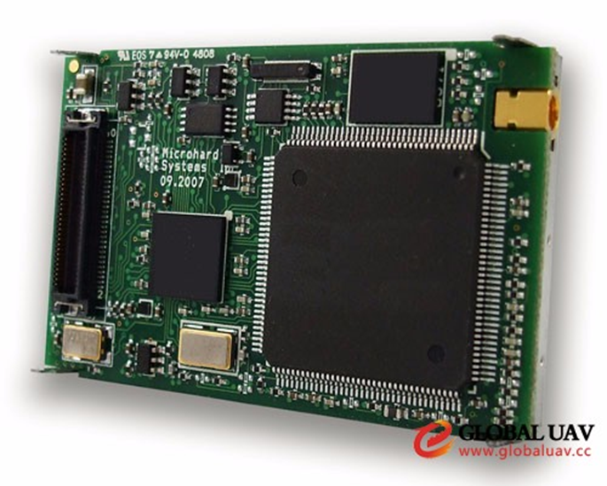
Microhard MHX-2420 OEM
The MHX2420 features robust, low latency, secure data communications at a low cost.
It has full serial port and separate diagnostics port for real-time diagnostics without interrupting data communications. Excellent noise figure, superior interference rejection, very agile frequency synthesis, digital modulation, and matched filter detection, are among the many advantages to using the MHX2420.

Slide 79
Microhard MHX-2420 OEM
Features
Frequency range: 2.4 – 2.4835GHz (S-band)
Range: 30+ miles (50+ km) (dependant on link rate and line of sight)
Transparent, low latency link, providing 230 kbps continuous throughput to support protocols such as MODBUS.
Communicates with virtually all PLCs, RTUs, and serial devices.
Industrial Grade - extended temperature specification.
Supports Point-to-Point, Point-to-Multipoint, Peer-to-Peer, Store and Forward Repeater, TDMA, Multimaster.
Maximum allowable transmit power (1W).
Low power consumption in Sleep Mode and High Voltage Option
32 bits of CRC, selectable Forward Error Correction with retransmission.
Separate diagnostics port - transparent remote diagnostics and network control.

Slide 80
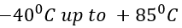
Microhard MHX-2420 OEM
Specifications
Cost
Weight: 55 grams
Temperature range:
Dimensions: (89mm x 53.4mm x 17.8mm)
Output Power: 100mW to 1W
I/O Voltage: (user selectable) 3.3VDC to 5.5VDC;
Serial Baud Rate: 300bps to 230.4kbps
Link Rate: 19.2 kbps - 230.4kbps
Less than $1000 (confirmed)

Slide 81
Antennas Comparison
Antenna Group | Model | Manufacturer | Number Needed | Unit Price | Power Requirement
Rubber Ducky | MHS031100 | Microhard Systems Inc | 1 | TBC | 1W
Transit Antennas | MHS031270 | Microhard Systems Inc | 1 | TBC | 0.398W
Patch Antennas | MHS034200 ISM | Microhard Systems Inc Endurosat | 1 1 | TBC $3600 | 0.2W <4W
Yagi Antennas | MHS034100 | Microhard Systems Inc | 1 | TBC | 0.398W
Omni Directional | MHS031260 | Microhard Systems Inc | 1 | TBC | 1W

Slide 82
COMMS BOM
Component | Description | Quantity Needed | Unit Price | Total
STM32 | MCU | 1 | $44.89 | $44.89
Antenna | Patch Antenna | 1 | $3600 | $3600
MHX2420 | S-BAND Transceiver | 1 | <$1000 | <$1000
ESTIMATED GRAND TOTAL | KES. 464,500

Slide 83
Challenges
Component supply uncertainty
Delayed communication from vendors.
Vendors don't display all the information clearly on their sites.
High prices from vendors.

Slide 84
Thank You

Slide 85
Electrical Power Subsystem
Presented by:
Amos Wanene| Eunice Orenge |Hillary Omondi |Shadrack Kipkemoi

Slide 86
EPS Functions
Power Generation: primarily from solar panels: panel parameters and architecture.
Power Storage: primarily done using battery technology: choice of batteries and configuration.
Power Conditioning i.e. Regulation and control: Converter sizing and architecture
Power Distribution to the spacecraft systems. Should support power requirements for average and peak electrical load.
Provide command and telemetry capability for EPS health and status.
Protect the spacecraft against failures within EPS: making use of different operation modes such as low power, normal and transmission mode.
Suppress transient bus voltages and protect against bus faults

Slide 87
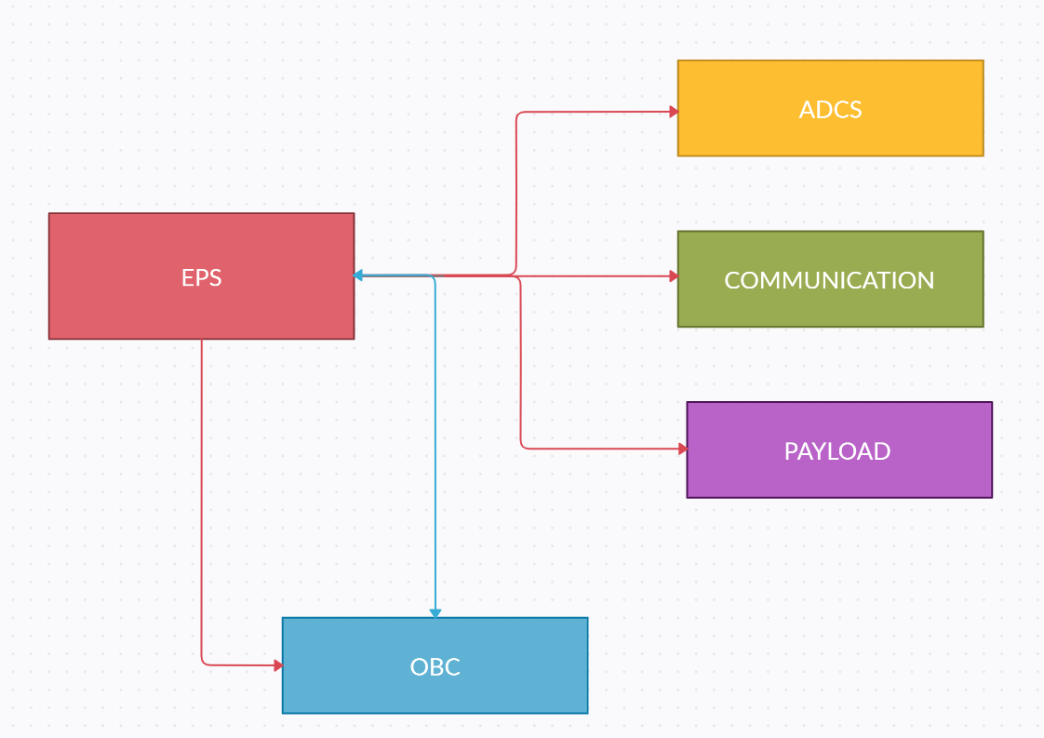
Interconnection Diagram
Key
i. Red: Power line
ii. Blue: Signal line

Slide 88
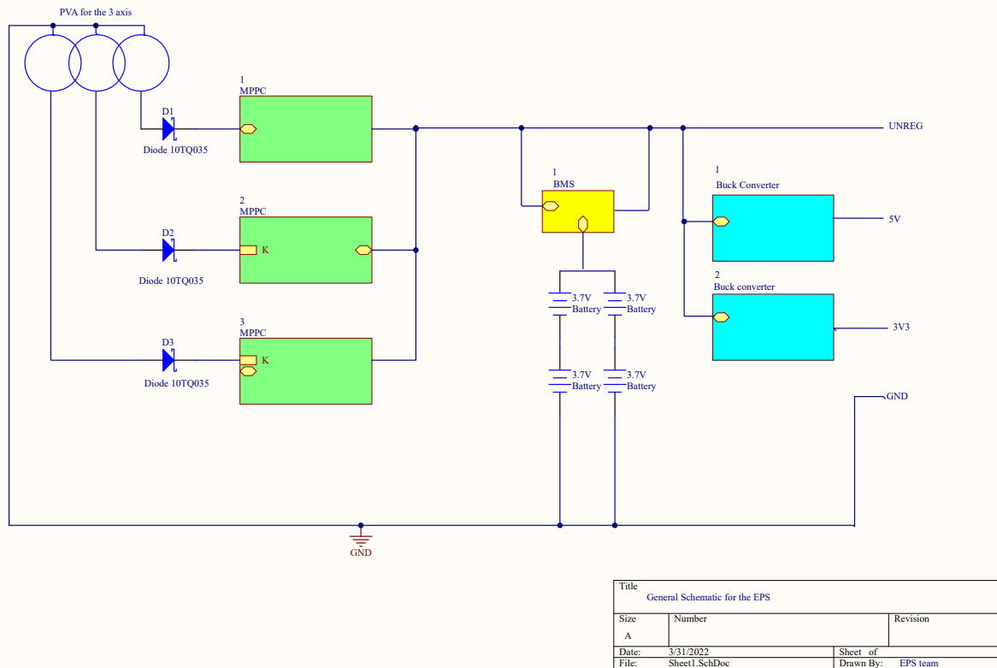
General Layout of the EPS

Slide 89
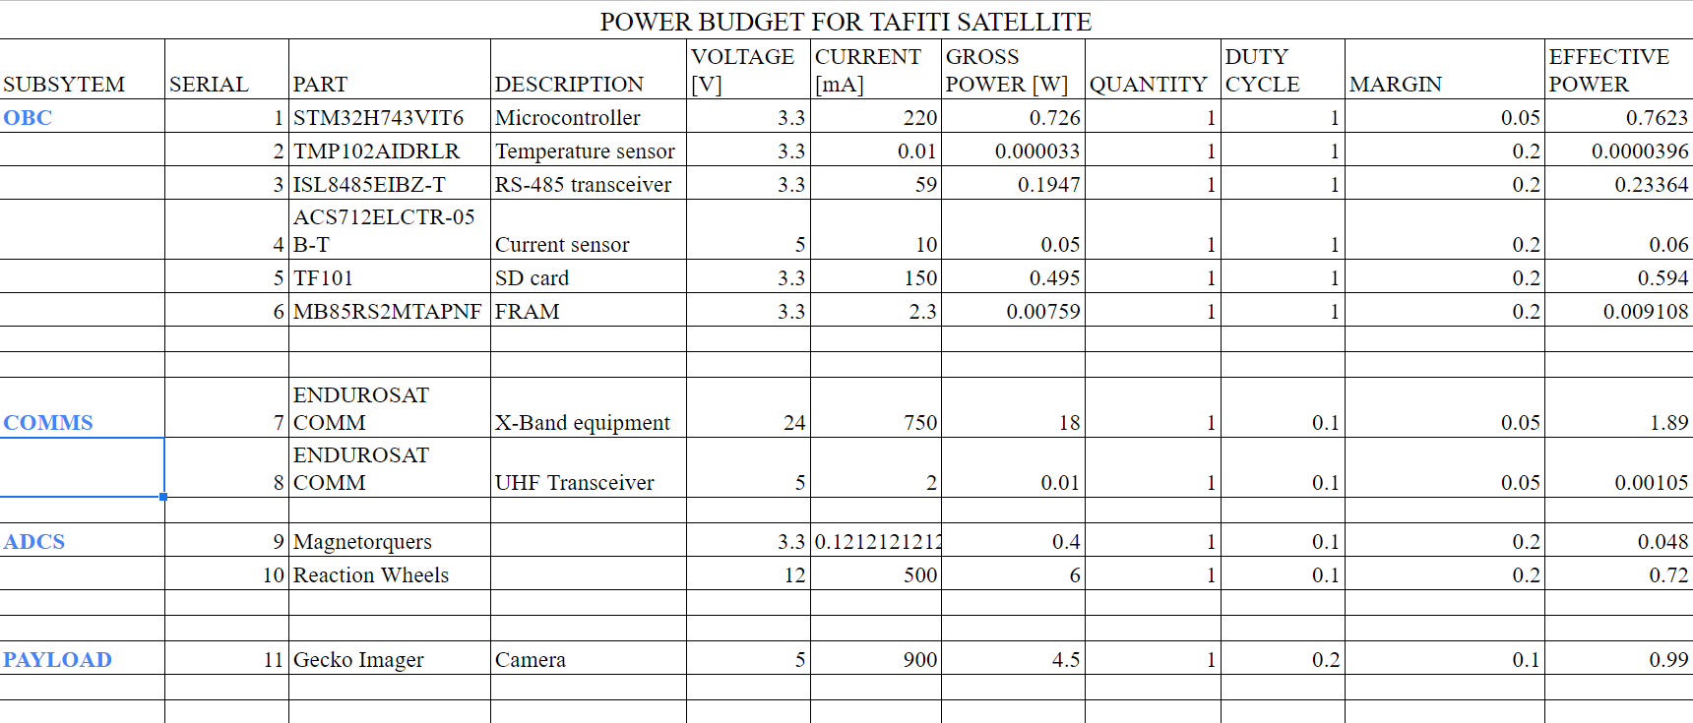
Power Budget

Slide 90
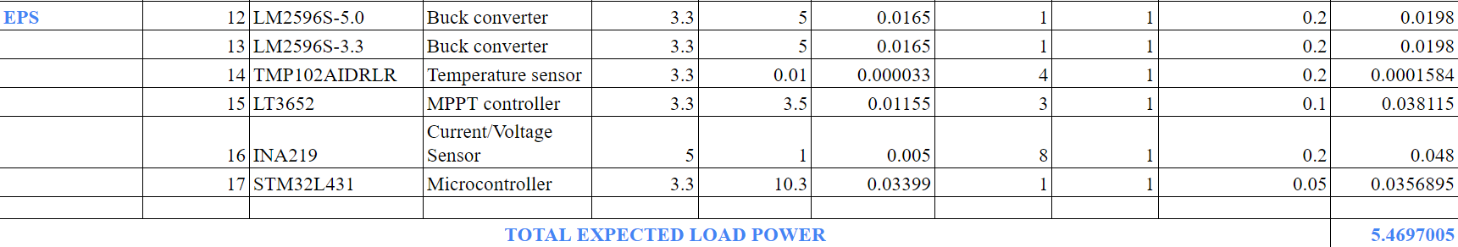
Power Budget

Slide 91
Orbital Average Power
OAP = ηconv*η*Aeff*Cs
Where ηconv=80%
η=10%
Aeff=((95*95mm)*3)*2
Cs=1321W/m^2
Hence OAP=5.722572W

Slide 92
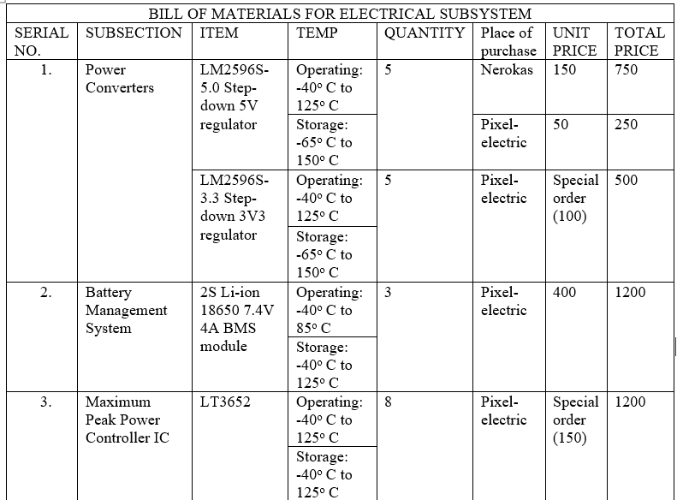
BoM

Slide 93
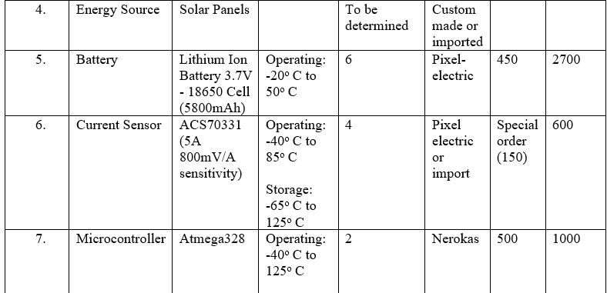
BoM

Slide 94
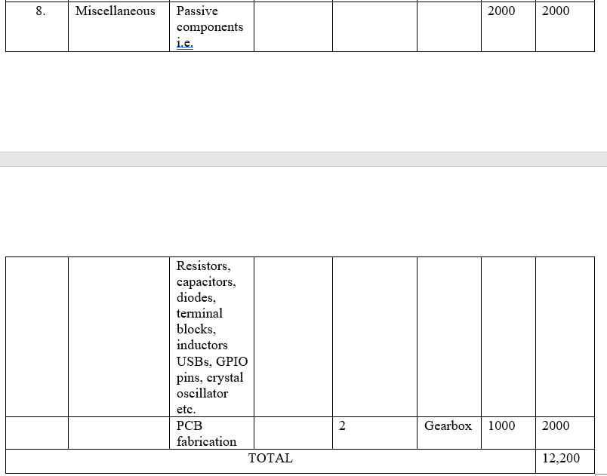
BoM

Slide 95
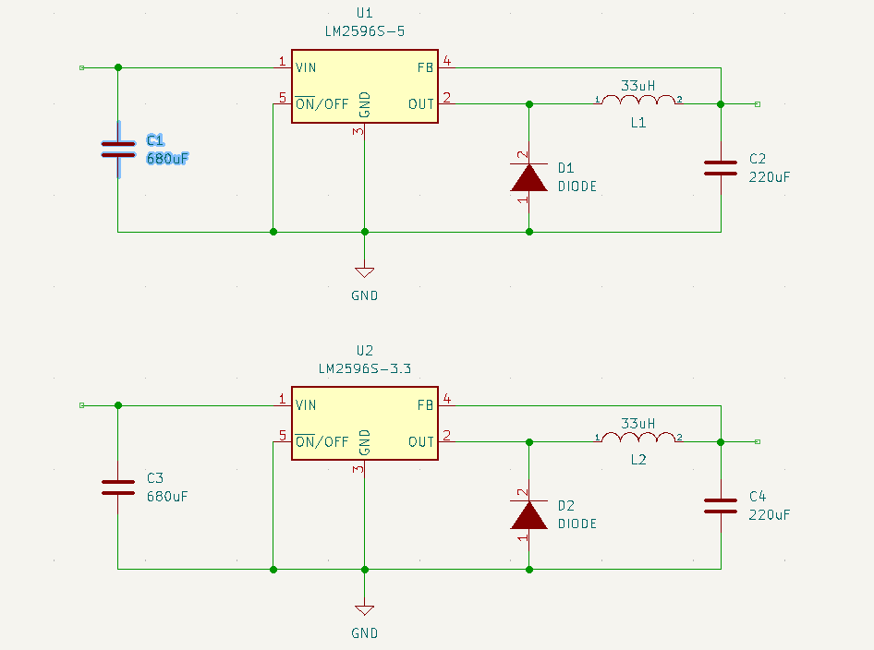
Schematics for Power Converters

Slide 96
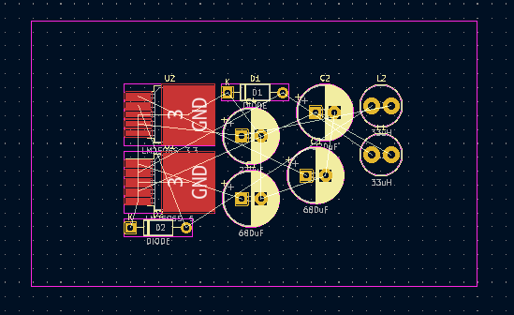
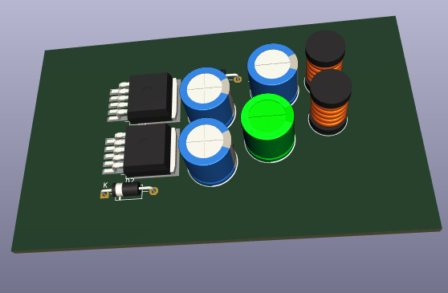
PCB & 3D Layout Diagrams

Slide 97
Thank You

Slide 98
STRUCTURE & THERMAL CONTROL SUBSYSTEM
BY:
H. Wanjau/ C. Otieno/ A. Otwori/ A. Areeb/ J. Ayako

Slide 99
Functions of the Structure
The Tafiti structure is a 3U mechanical design that houses the rest of the subassemblies. The main functions of the structure is to:
Mount the sub-assemblies together.
Protect the components from radiation.
Aid in thermal Control.

Slide 100
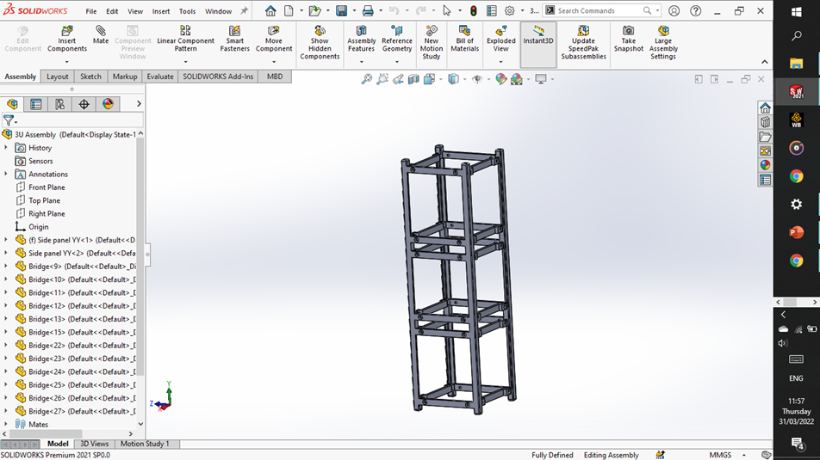
Proposed Structure Design

Slide 101
Structures and Thermal Control Subsystem
Proposed materials for use in the Structure: Aluminium 6061 T6 or 7075 T6
However, Aluminium 6061 is a more viable option.
Possible fabrication method is laser cutting
Thermal Control: Passive Thermal Control - Polishing and anodizing

Slide 102
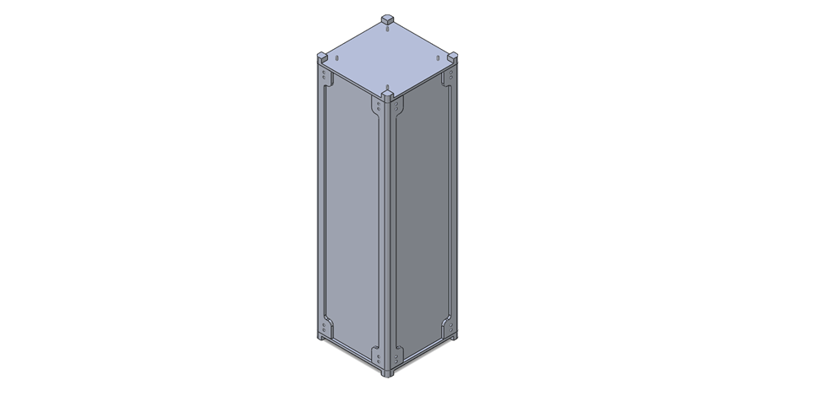
CAD Model
:

Slide 103
Simulations
Modal Analysis
The frequency of vibration experienced during launch is expected to be around 100Hz and thus to avoid resonance, the natural frequency of the structure should therefore be much larger than 100Hz.
The fixtures were applied on the 8 recesses as those points will be held by the rails in the P-Pod during launch.

Slide 104
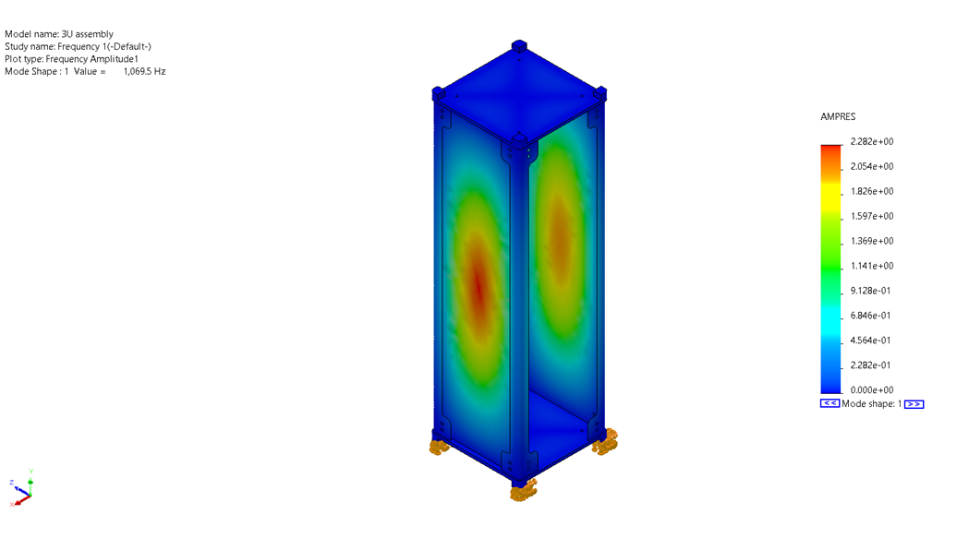
Modal Analysis
:
The natural frequency was approximately 1000 Hz adequate to avoid resonance.

Slide 105
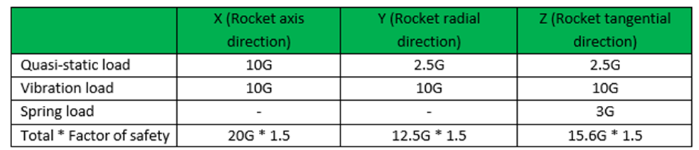
Static Stress Analysis
The stresses experienced during launch are down to the gravitational acceleration. Assumptions made about the strength requirement of the rocket are shown below:

Slide 106
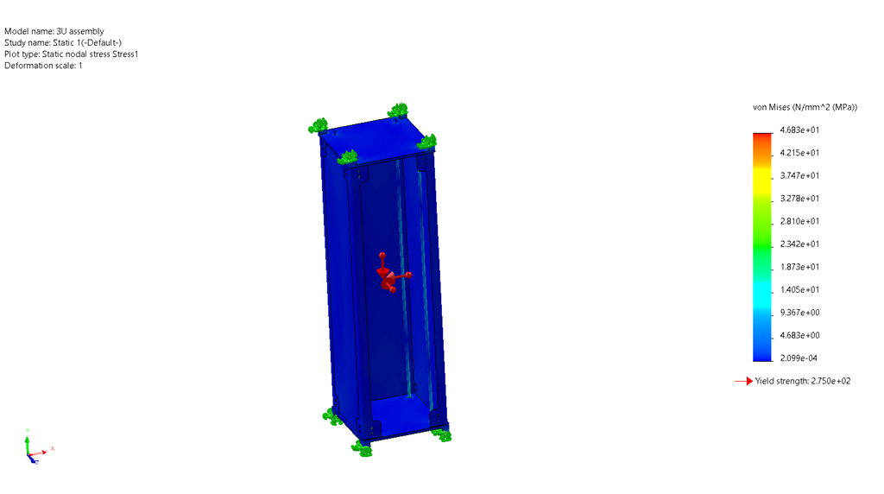
Static Stress Analysis
:

Slide 107
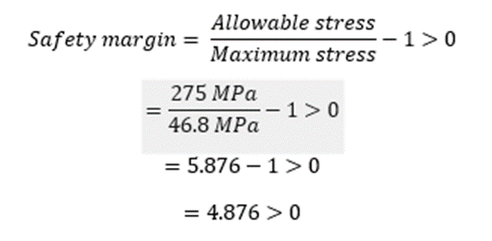
Static Stress Analysis
The simulation undertaken using the loads assumed that the largest stress induced was 46.8 Mpa. The allowable stress of Aluminum 6061 T6 is 275 Mpa.
The Safety margin can be determined by:
Hence Safe

Slide 108
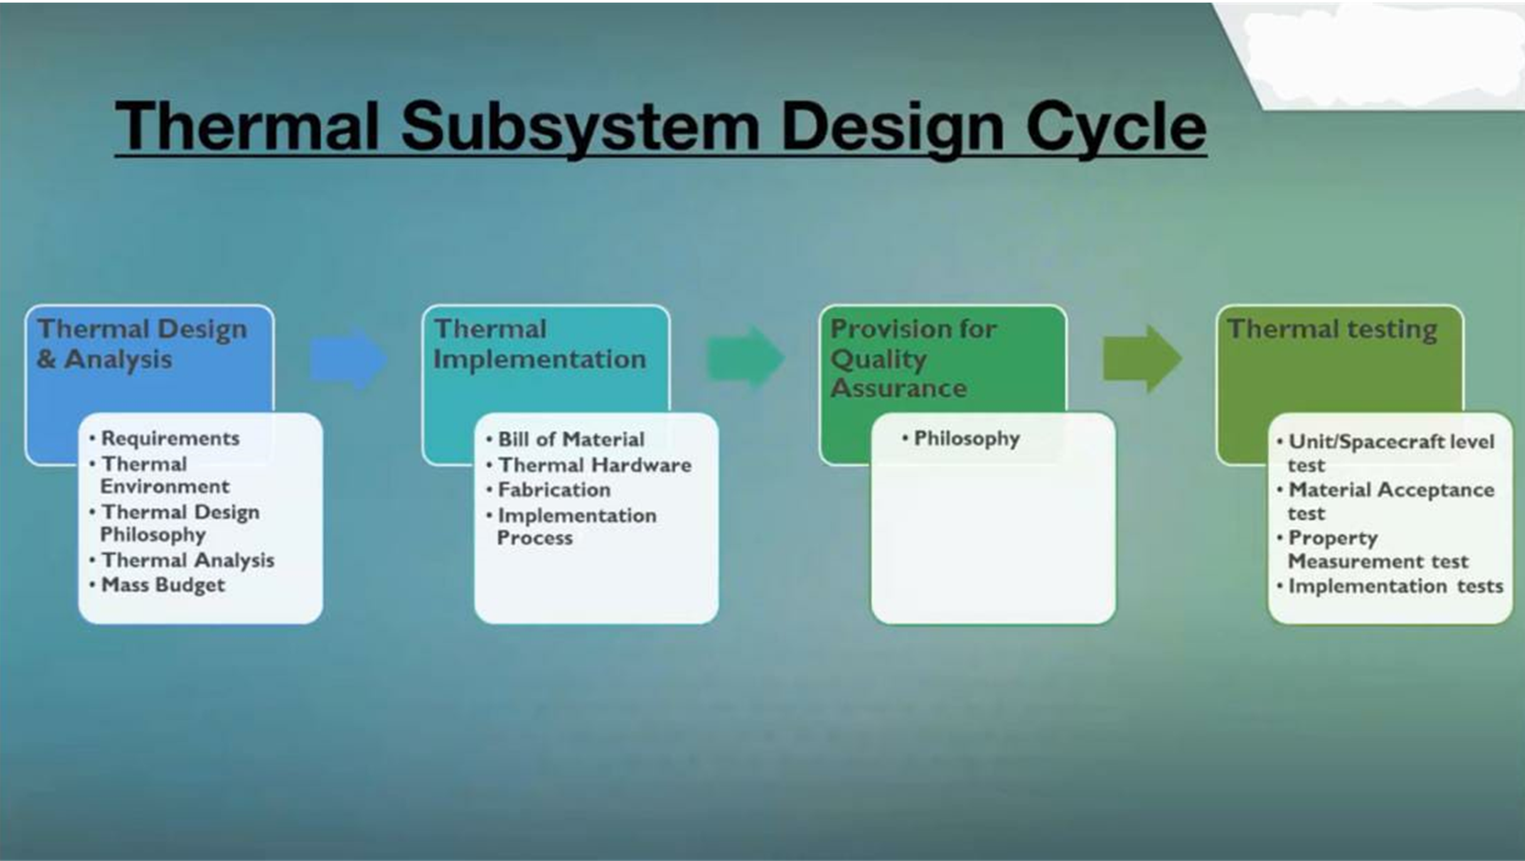
Thermal Control
Thermal Design Cycle:

Slide 109
Thermal Control
Tafiti would orbits the earth every 97 minutes on the SSO. In this time, it will transit the terminator line twice. In each of these transitions, the temperature varies between 86oC and -70oC.
If the Tafiti structure is to maintain a long-term operation to fulfil the mission, there needs a way to control both external and internal temperatures.
The goal of the thermal control system is to keep the CubeSat within the working temperature range of all components within the CubeSat

Slide 110
Passive Thermal Control
Thermal control will be achieved by:
Anodizing the surface of Aluminum 6061 T6
Polishing the surface of the surface of Aluminum 6061 T6 to 0.5 microns to reduce the effective surface area by reducing the height differences.
Internal temperature control will be done by placing the components that emit heat such as the EPS close to components that require heat such as the batteries while taking into account the mass balance.

Slide 111
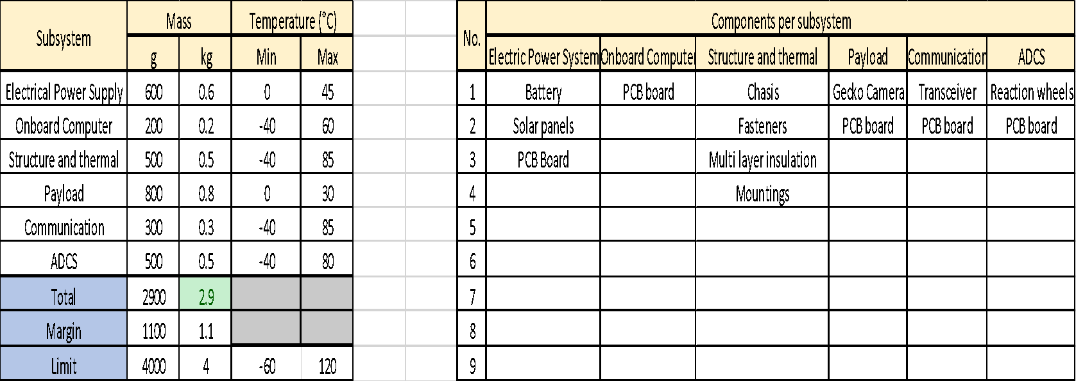
Mass and Thermal Budget

Slide 112
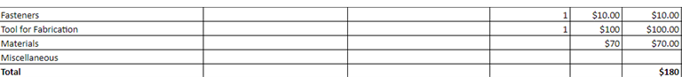
Bill of Materials

Slide 113
Thank You

Slide 114
A.D.C.S SUBSYSTEM
BY:
T. Stower/ S. Vigil/ O. Philip/ K. Ashley

Slide 115
The ADCS is divided into 4 modules.
• The SENS is composed of a set of sensors. This set will have to harvest data in order to get information about the CubeSat position.
• The ACT are the CubeSat attitude actuators. ACT will have to adapt the CubeSat’s attitude according to the mission needs.
• The ADCS controller (CTRL) objectives are to collect data from sensors and to process it to get reliable positioning information. Then the ADCS will send orders to ACT in order to correct/modify the CubeSat’s attitude if OBC and EPS subsystems allow it.
• The Interface (INT) module has for objective to ensure good connection with other systems of the satellite and to send data to the other system.

Slide 116
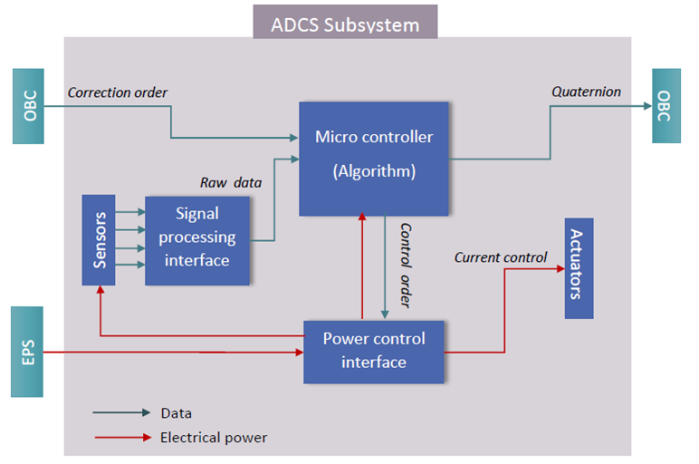
ADCS General system architecture
Available Control Algorithms:
• Detumbling
• Sun pointing
• Nadir pointing
• Reaction wheel desaturation

Slide 117
Sensors
Objective: Calculate CubeSat orientation and chose best physical input for actuators.
Estimate an angular rotation:
Gyroscope
Sun sensor
Star tracker******
Horizon sensors
Magnetometer
Temperature sensors
Actuators
Objective: Collect useful data for attitude determination.
Estimate an angular rotation:
Reaction wheel
Momentum wheel
Control momentum gyroscope
Magnetorquer

Slide 118
Hardware
ADCS hardware has to:
Get the sensor data.
Process the data.
Sample/correct them (for example Kalman filter).
Determine the current attitude
Determine the target attitude
Control the magnetorquers to reach the target attitude.
There are different hardware method to achieve the ADCS CTRL function.
By using a FPGA card
By using a PIC-Controller

Slide 119
Software approach
The software will handle the same functions that we enumerated for the hardware because both are very close. So obviously, the software will be designed to realize the same functions:
● Get the sensors’ data
● Process, sample and correct the data (Kalman Filter)
● Determine the target attitude with ADCS CTRL Algorithm
● Calculate the rotations to reach the target attitude
● Control the actuators to modify the attitude accordingly
Simulations
We need to run simulations to validate our choice of components. The software will need:
● To simulate the concerned part in the space environment (force models, vacuum, radiation, temperature…).
● To take parameters (such as elevation, weight …) modifiable

Slide 120
Budgeting
Sensor/ Actuator | Model | Manufacturer | Number Needed | Unit Price | Power Requirement
Sun Sensor | Coarse | Comtech AA | 5 | $13,207.00 | None
Sun Sensor | Fine | SSBV Space and Ground Systems | 1 | $5,000.00 | < 140 mW
Magnetometer | HMC5883L | Honeywell | 1 | $14.95 | 0.25mW
Gyroscope | ADXRS450 | Analog Devices | 1 | $59.54 | 30 mW
GPS | SGR-05U | Surrey | 1 | $18,000.00 | 80mW
Magnetorquer | MTO.2-1 Power Optimized | ZARM Technik AG | 3 | $1,980.00 | 140 mW

Slide 121
Thank You

